Slide 1
ITMD 421 – Data Modeling and Applications
Aastha Gupta
Lecture 3
September 11, 2017

Slide 2
Objectives
Functional Dependencies
Normalization

Slide 3
Design Theory
Design theory is about how to represent your data to avoid anomalies.
It is a mostly mechanical process
Tools can carry out routine portions

Slide 4
Normal Forms
1st Normal Form
2nd Normal Form
Boyce-Codd Normal Form
3rd Normal Form
4th and 5th Normal Forms

Slide 5
Constraints Prevent (some) Anomalies in the Data
A poorly designed database causes anomalies
Student | Courses | Room
Mary | CS145 | B01
Sam | CS145 | B01
Joe | CS145 | B01
… | ….
Since one is in only one room; it contains redundant information

Slide 6
Constraints Prevent (some) Anomalies in the Data
A poorly designed database causes anomalies
Student | Courses | Room
Mary | CS145 | B01
Sam | CS145 | C12
Joe | CS145 | B01
… | ….
If we update the room number for one row, we get inconsistent anomaly: an update anomaly

Slide 7
Constraints Prevent (some) Anomalies in the Data
A poorly designed database causes anomalies
Student | Courses | Room
… | ….
If everyone drops the class , we lose what room the class is in: a delete anomaly

Slide 8

Constraints Prevent (some) Anomalies in the Data
A poorly designed database causes anomalies
We cannot reserve a room without students : an insert anomaly
 | CS 229 | C12

Slide 9
Constraints Prevent (some) Anomalies in the Data
Student | Course
Mary | CS145
Joe | CS145
Sam | CS145
… | ….
Course | Room
CS145 | B01
CS229 | C12
Is this form better?
Redundancy?
Update anomaly?
Insert anomaly?
Delete anomaly?

Slide 10
Functional Dependencies
Attribute Y is functionally dependent on attribute X if and only if the value of X uniquely determines the value of Y
Also “X determines Y”, “X → Y”
X is called the determinant
Y is called the dependent attribute
The repetition of Y (with every X) creates redundancy

Slide 11
Example
Consider a relation R(A,B,C,D)
A | B | C | D
1 | 1 | 2 | 3
1 | 2 | 2 | 3
1 | 3 | 2 | 3
2 | 4 | 5 | 6
5 | 6 | 7 | 8
Which of the following dependencies are satisfied by this relation?
A->B
A->CD
AB->CD
C->D
B->A
BD->AC
AD->BC
D->B
D->C
C->A

Slide 12
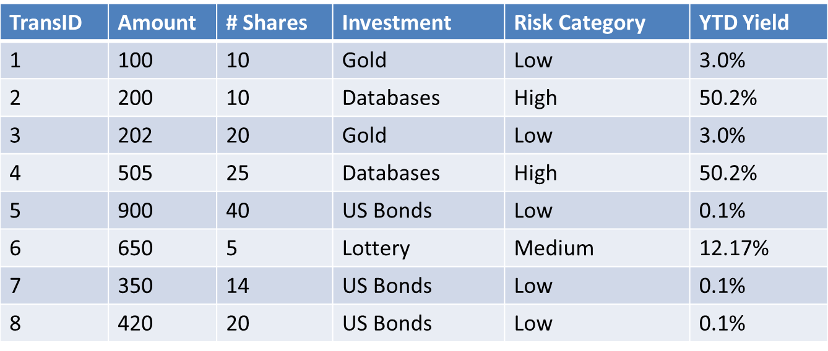
Data and FDs

Slide 13
Observing FDs in Data
Investment → Risk Category
Investment → YTD Yield

Slide 14
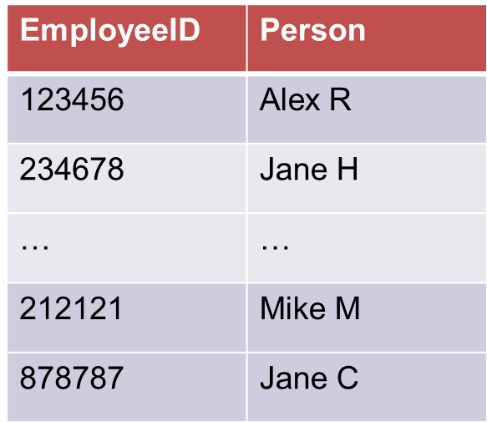
Enforcing Functional Dependencies
A primary key determines all attributes
Simple for DBMS to enforce (make every primary key value is unique)
X → Y when
(X₁,Y₁) and (X₁,Y₂) exist
Not possible when X never repeats

Slide 15

Enforcing Functional Dependencies
What about other FDs?
Hard to enforce…

Slide 16
Apply Normalization Process
Decompose schema (break up the tables into more tables)
Eliminate redundancy
Simplify enforcing of FDs
Intuitively
Let every FD have its own table (i.e. FD determinant becomes a primary key)

Slide 17
Goals of Decomposition
Want to be able to reconstruct what you started with (lossless)
Dependency preservation
Minimize the cost of integrity constrains
Redundancy avoidance
Avoid any unnecessary data duplication

Slide 18
Schema Decomposition
(TransID, Amount, Shares, Investment, Risk Category, YTD Yield)
Investment → Risk Category, YTD Yield
(TransID, Amount, Shares, Investment)
(Investment, Risk Category, YTD Yield)

Slide 19
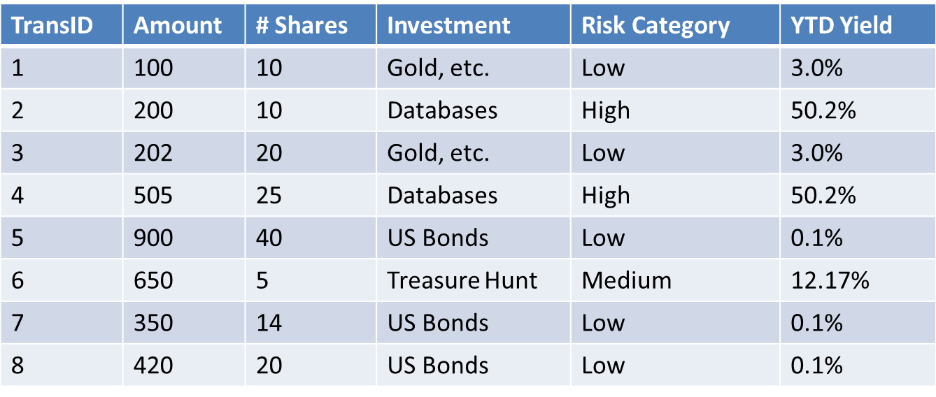
Schema Decomposition
(TransID, Amount, Shares, Investment, Risk Category, YTD Yield)

Slide 20
Schema Decomposition
(TransID, Amount, Shares, Investment) (Investment, Risk Category, YTD Yield)
TransID | Amount | # Shares | Investment
1 | 100 | 10 | Gold, etc.
2 | 200 | 10 | Databases
3 | 202 | 20 | Gold, etc.
4 | 505 | 25 | Databases
5 | 900 | 40 | US Bonds
6 | 650 | 5 | Treasure Hunt
7 | 350 | 14 | US Bonds
8 | 420 | 20 | US Bonds
Investment | Risk Category | YTD Yield
Gold, etc. | Low | 3.0%
Databases | High | 50.2%
Gold, etc. | Low | 3.0%
Databases | High | 50.2%
US Bonds | Low | 0.1%
Treasure Hunt | Medium | 12.17%
US Bonds | Low | 0.1%
US Bonds | Low | 0.1%

Slide 21
Schema Decomposition
(TransID, Amount, Shares, Investment) (Investment, Risk Category, YTD Yield)
TransID | Amount | # Shares | Investment
1 | 10 | 10 | Gold, etc.
2 | 200 | 10 | Databases
3 | 202 | 20 | Gold, etc.
4 | 505 | 25 | Databases
5 | 900 | 40 | US Bonds
6 | 650 | 5 | Treasure Hunt
7 | 350 | 14 | US Bonds
8 | 420 | 20 | US Bonds
Investment | Risk Category | YTD Yield
Gold, etc. | Low | 3.0%
Databases | High | 50.2%
US Bonds | Low | 0.1%
Treasure Hunt | Medium | 12.17%
Investment →
Risk Category, YTD Yield

Slide 22
FDs are not Symmetric
X → Y does not mean Y → X
What happens when X → Y AND Y → X?

Slide 23
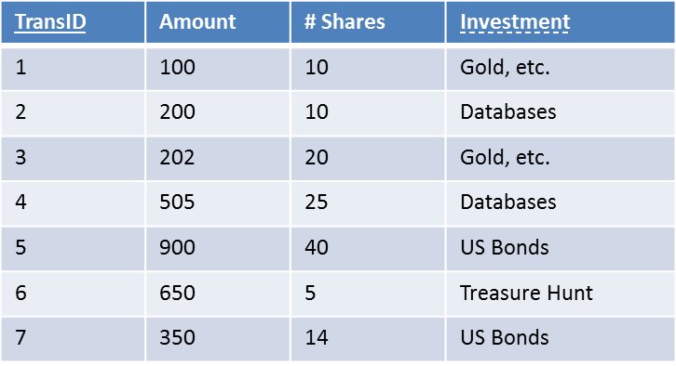
Functional Dependencies
An attribute may determine more than one attribute: i.e. X → Y,Z
Same as X → Y and X → Z
A shorthand (a.k.a. Union rule)
Primary key determines every single attribute in the table:
TransID → Amount
TransID → # Shares
TransID → Investment

Slide 24
Functional Dependencies
An attribute may be determined by more than one attribute: X,Y → Z
Does not mean either X → Z or Y → Z
Need both together X and Y to determine Z
Composite primary key

Slide 25
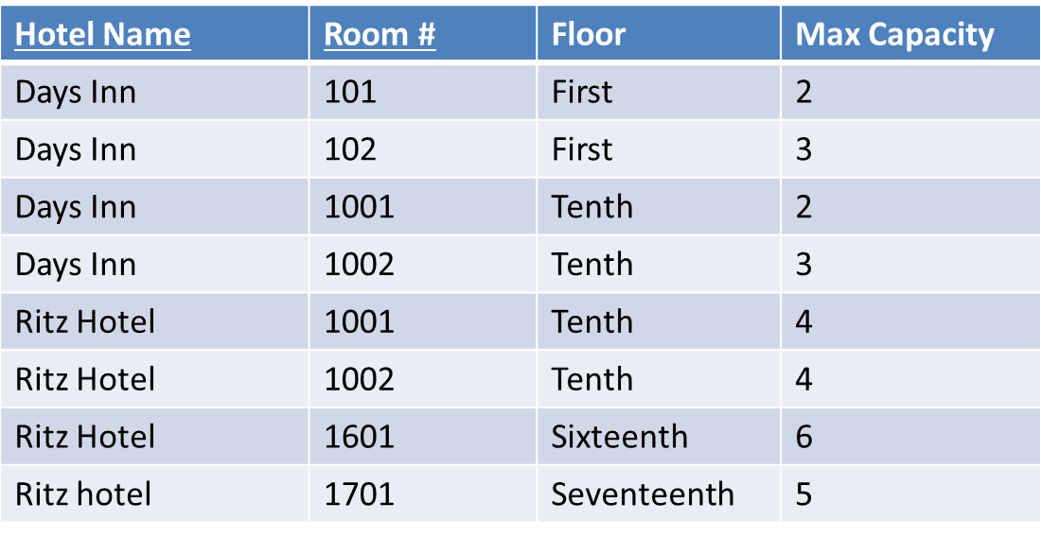
FDs and Composite Key
Hotel Name, Room # → Floor
Hotel Name, Room # → Max Capacity

Slide 26
Data Duplication
Room # → Floor
Hotel Name, Room # → Max Capacity

Slide 27
Schema Decomposition
Split the “Room# → Floor” off as a table
Hotel Name | Room # | Max Capacity
Days Inn | 101 | 2
Days Inn | 102 | 3
Days Inn | 1001 | 2
Days Inn | 1002 | 3
Ritz Hotel | 1001 | 4
Ritz Hotel | 1002 | 4
Ritz Hotel | 1601 | 6
Ritz hotel | 1701 | 5
Room # | Floor
101 | First
102 | First
1001 | Tenth
1002 | Tenth
1001 | Tenth
1002 | Tenth
1601 | Sixteenth
1701 | Seventeenth

Slide 28
Result of Schema Decomposition
Split the “Room# → Floor” off as a table
Hotel Name | Room # | Max Capacity
Days Inn | 101 | 2
Days Inn | 102 | 3
Days Inn | 1001 | 2
Days Inn | 1002 | 3
Ritz Hotel | 1001 | 4
Ritz Hotel | 1002 | 4
Ritz Hotel | 1601 | 6
Ritz hotel | 1701 | 5
Room # | Floor
101 | First
102 | First
1001 | Tenth
1002 | Tenth
1601 | Sixteenth
1701 | Seventeenth

Slide 29
Functional Dependency Rules
Reflexivity
If Y ⊆ X, X → Y
Augmentation
If X → Y then WX → WY
Transitivity
If X → Y and Y → Z then X → Z

Slide 30
Functional Dependency Rules
Union
If X → Y, X → Z then X → YZ
Decomposition
If X → YZ then X → Y and X → Z
BUT NOT XY → Z, then X → Z and Y → Z
Pseudo-transitivity
If X → Y and WY → Z then WX → Z

Slide 31
Example
(StudentID, Name, School, Location)
StudentID → Name
Name → School
School → Location

Slide 32
Example
StudentID → School (Transitivity)
StudentID → Location (Transitivity)
StudentID → StudentID (Reflexivity)
StudentID → Name (given)
StudentID → StudentID, Name, School, Location (Union)

Slide 33
Goals of Decomposition
Want to be able to reconstruct what you started with (lossless)
Dependency preservation
Minimize the cost of integrity constrains
Redundancy avoidance
Avoid any unnecessary data duplication

Slide 34
Decomposing a Schema
Name | Age | Salary
J. Smith | 35 | 90K
B. Doe | 38 | 135K
K. Parks | 35 | 93K
S. Jones | 41 | 115K
1
2
Name | Age
J. Smith | 35
B. Doe | 38
K. Parks | 35
S. Jones | 41
Name | Salary
J. Smith | 90K
B. Doe | 135K
K. Parks | 93K
S. Jones | 115K
Name | Age
J. Smith | 35
B. Doe | 38
K. Parks | 35
S. Jones | 41
Age | Salary
35 | 90K
38 | 135K
35 | 93K
41 | 115K

Slide 35
Decomposing a Schema: Option 1
Name | Age
J. Smith | 35
B. Doe | 38
K. Parks | 35
S. Jones | 41
Age | Salary
35 | 90K
38 | 135K
35 | 93K
41 | 115K
Name | Age | Salary
J. Smith | 35 | 90K
J. Smith | 35 | 93K
B. Doe | 38 | 135K
K. Parks | 35 | 90K
K. Parks | 35 | 93K
S. Jones | 41 | 115K

Slide 36
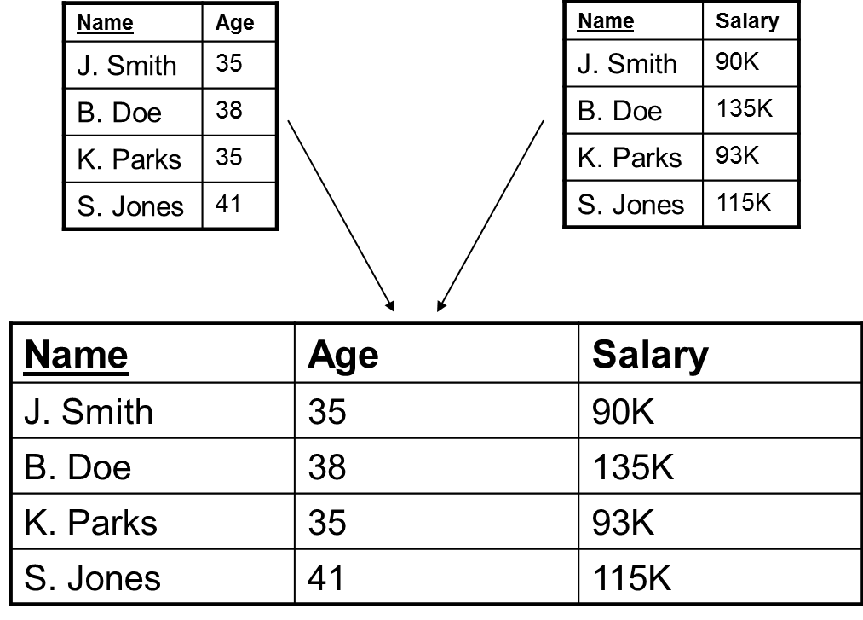
Decomposing a Schema: Option 2

Slide 37
Decomposing a Schema
Gate | ArrivalIn | Destination
A1 | 10 | Paris
A2 | 15 | Berlin
A3 | 15 | Boston
A4 | 25 | Chicago
1
2
Gate | ArrivalIn
A1 | 10
A2 | 15
A3 | 15
A4 | 25
ArrivalIn | Destination
10 | Paris
15 | Berlin
15 | Boston
25 | Chicago
Gate | ArrivalIn
A1 | 10
A2 | 15
A3 | 15
A4 | 25
Gate | Destination
A1 | Paris
A2 | Berlin
A3 | Boston
A4 | Chicago

Slide 38
First Normal Form (1NF)
First Normal Form: Each domain of a column must contain only atomic values, and each column in a record must have at most one value from its domain
1NF is typically our starting point

Slide 39
1st Normal Form (1NF)
1NF Constraint: Types must be atomic!
Student | Courses
Mary | {CS145, CS229}
Joe | {CS145, CS106}
… | …
Student | Courses
Mary | CS145
Mary | CS229
Joe | CS145
Joe | CS106
In 1st NF
Violates 1NF

Slide 40
Second Normal Form (2NF)
Prime attribute
An attribute, which is a part of the prime-key, is known as a prime attribute.
Attribute set that belongs to any candidate key can also be called Prime Attributes.
Non-prime attribute
An attribute, which is not a part of the prime-key, is said to be a non-prime attribute.
Attribute set does not belongs to any candidate key can also be called Non Prime Attributes

Slide 41
Second Normal Form (2NF)
The table is required to be in First Normal Form.
There should be no partial key dependencies.
All the non-key columns are dependent on the table’s primary key.

Slide 42
Second Normal Form (2NF)
Partial Functional Dependency
A -> B is a partial FD, if some attribute of A can be removed and the FD still holds
Formally, there is some proper subset of A, C is a subset of A, such that C -> B
All the non-key columns are dependent on the table’s primary key.

Slide 43
Removing Partial Dependencies
Identify the table purpose and ask “Does this column serve to describe what the primary key identifies?”
If you answer “yes,” then the column is dependent on the primary key and belongs in the table.
If you answer “no,” then the column should be moved different table.

Slide 44
Converting 1NF to 2NF
(EmpID, EmpLName, EmpFName, Dept, ProjCode, Hours)
Two FDs are given:
EmpID →EmpLName, EmpFName, Dept
EmpID, ProjCode →Hours

Slide 45
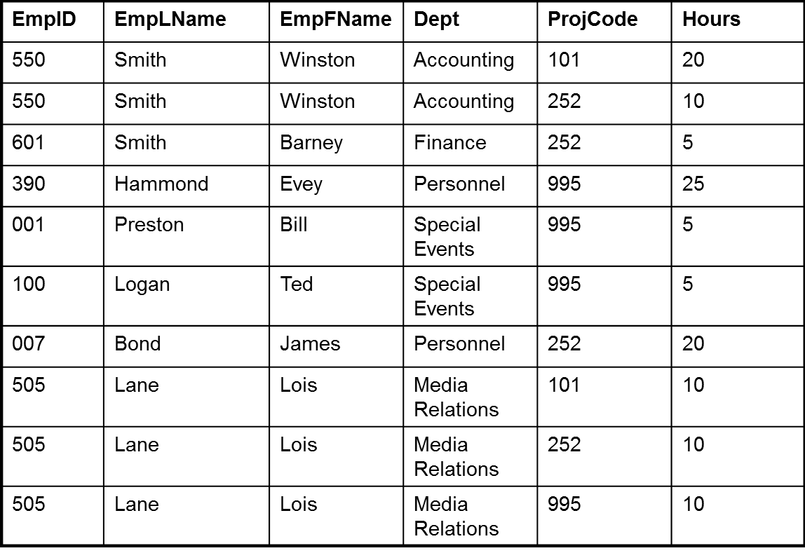
1NF vs 2NF Data

Slide 46
Converting 1NF to 2NF
Decompose (EmpID, EmpLName, EmpFName, Dept, ProjCode, Hours)
Remove the offending FD
EmpID →EmpLName, EmpFName, Dept
Two tables
(EmpID, EmpLName, EmpFName, Dept)
(EmpID, ProjCode, Hours)

Slide 47
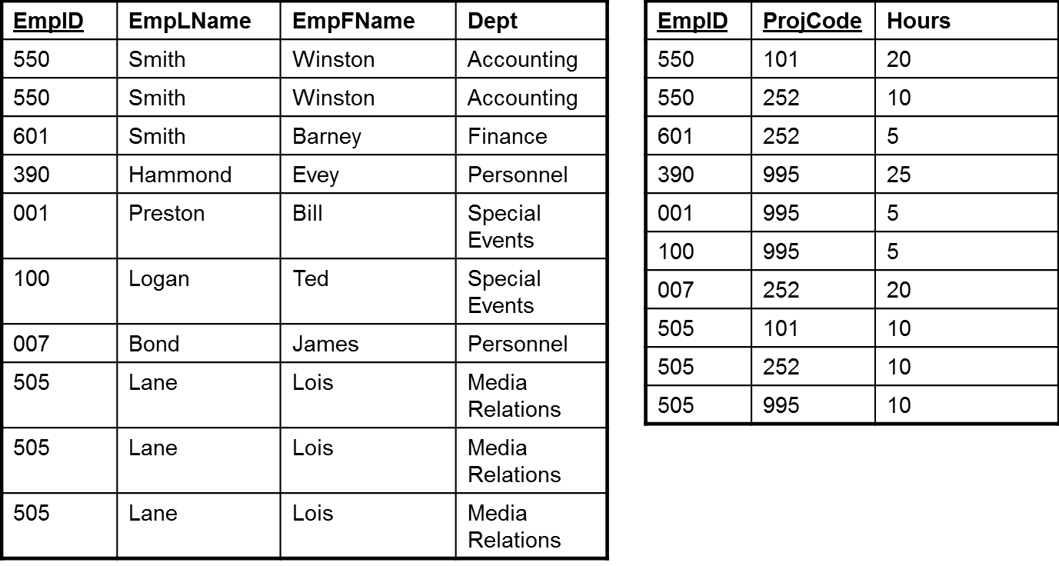
Towards 2NF

Slide 48
Towards 2NF
EmpID | EmpLName | EmpFName | Dept
550 | Smith | Winston | Accounting
601 | Smith | Barney | Finance
390 | Hammond | Evey | Personnel
001 | Preston | Bill | Special Events
100 | Logan | Ted | Special Events
007 | Bond | James | Personnel
505 | Lane | Lois | Media Relations
EmpID | ProjCode | Hours
550 | 101 | 20
550 | 252 | 10
601 | 252 | 5
390 | 995 | 25
001 | 995 | 5
100 | 995 | 5
007 | 252 | 20
505 | 101 | 10
505 | 252 | 10
505 | 995 | 10

Slide 49
Third Normal Form (3NF)
Third Normal Form: 2NF, plus every attribute in the table is determined only by the primary key of the table.
To get 3NF, eliminate transitive dependencies
A transitive dependency is a functional dependency where the determinant is not part of the primary key

Slide 50
Removing Transitive Dependencies
Find all dependencies where the determinant is not part of the primary key
Starting with the smallest subset, do the following:
1. Remove all attributes on the right-hand side from the table and put them in a new table
2. Add the attributes in the determinant to the new table; make them the primary key, and make them a foreign key in the original table linked to the new table
3. Remove from the remaining transitive dependencies any attributes removed from the original table

Slide 51
Towards 3NF
(First , Last, Address, City, State, Zip)
First, Last → First, Last, Address, City, State, Zip
Given FD:
Zip → City, State

Slide 52
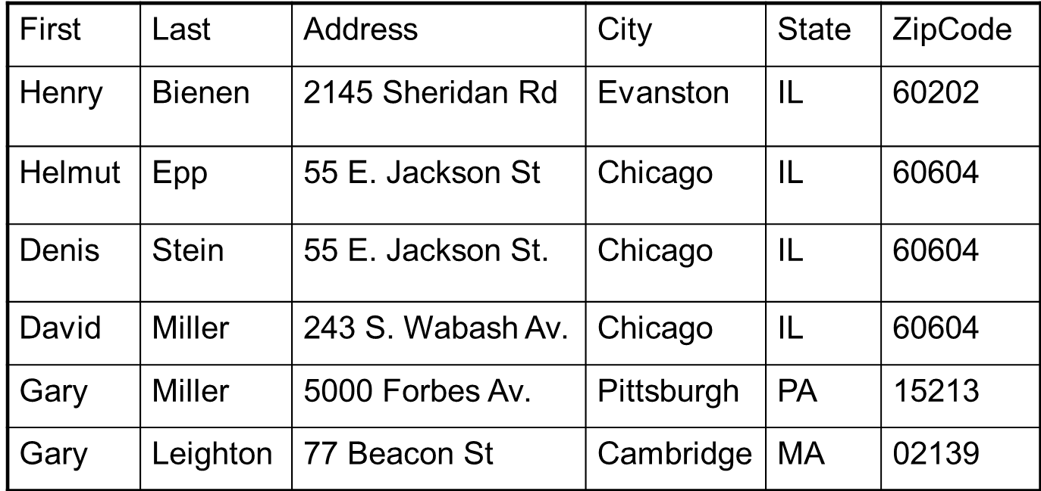
2NF Data Table

Slide 53
Decompose the Tables
First | Last | Address | ZipCode
Henry | Bienen | 2145 Sheridan Rd | 60202
Helmut | Epp | 55 E. Jackson St | 60604
Denis | Stein | 55 E. Jackson St. | 60604
David | Miller | 243 S. Wabash Av. | 60604
Gary | Miller | 5000 Forbes Av. | 15213
Gary | Leighton | 77 Beacon St | 02139
City | State | ZipCode
Evanston | IL | 60202
Chicago | IL | 60604
Chicago | IL | 60604
Chicago | IL | 60604
Pittsburgh | PA | 15213
Cambridge | MA | 02139

Slide 54
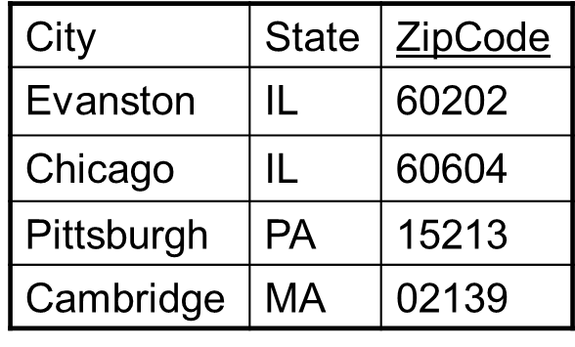
Decompose the Tables
First | Last | Address | ZipCode
Henry | Bienen | 2145 Sheridan Rd | 60202
Helmut | Epp | 55 E. Jackson St | 60604
Denis | Stein | 55 E. Jackson St. | 60604
David | Miller | 243 S. Wabash Av. | 60604
Gary | Miller | 5000 Forbes Av. | 15213
Gary | Leighton | 77 Beacon St | 02139
First, Last → First, Last, Address, ZipCode
ZipCode → City, State

Slide 55
Normalization Example
TimeSheet (Date, Employee#, HoursWorked, EmpName)
City-Rainfall (Month, Day, Year, Amount)
BankAccount (Account#, OwnerSSN, OwnerName, Balance)
School (ClassCode, ClassName, Credits, (StudentID, Grade, StudentName,
MajorCode, MajorName))

Slide 56
Example 2
Emp-Id | Emp-Name | Month | Sales | Bank-Id | Bank-Name
E01 | AA | Jan | 1000 | B01 | SBI
 |  | Feb | 1200
 |  | Mar | 850
E02 | BB | Jan | 2200 | B02 | UTI
 |  | Feb | 2500
E03 | CC | Jan | 1700 | B01 | SBI
 |  | Feb | 1800
 |  | Mar | 1850
 |  | Apr | 1725
Un-Normalized table

Slide 57
Emp-Id | Emp-Name | Month | Sales | Bank-Id | Bank-Name
E01 | AA | Jan | 1000 | B01 | SBI
E01 | AA | Feb | 1200 | B01 | SBI
E01 | AA | Mar | 850 | B01 | SBI
E02 | BB | Jan | 2200 | B02 | UTI
E02 | BB | Feb | 2500 | B02 | UTI
E03 | CC | Jan | 1700 | B01 | SBI
E03 | CC | Feb | 1800 | B01 | SBI
E03 | CC | Mar | 1850 | B01 | SBI
E03 | CC | Apr | 1725 | B01 | SBI
1st Normalized table

Slide 58
Emp-Id | Emp-Name | Month | Sales | Bank-Id |  | Bank-Id | Bank-Name
E01 | AA | JAN | 1000 | B01 |  | B01 | SBI
E01 | AA | FEB | 1200 | B01 |  | B02 | UTI
E01 | AA | MAR | 850 | B01
E02 | BB | JAN | 2200 | B02
E02 | BB | FEB | 2500 | B02
E03 | CC | JAN | 1700 | B01
E03 | CC | FEB | 1800 | B01
E03 | CC | MAR | 1850 | B01
E03 | CC | APR | 1726 | B01
2nd Normalized table

Slide 59
Another example
NIN | Contract No | Hours | Employee Name | Company ID | Company Location
616681B | SC1025 | 72 | P. White | SC115 | Belfast
674315A | SC1025 | 48 | R. Press | SC115 | Belfast
323113B | SC1026 | 24 | P. Smith | SC23 | Bangor
616681B | SC1026 | 24 | P. White | SC23 | Bangor
1. Explain in which normal form this table is
2. Find the Primary Key for this relation and explain your choice.
3. Find the Fully Functional Dependencies on the PK and the Partial Dependencies on the PK.
4. Normalise the table to 2NF
5. Find the transitive dependencies on the 2NF tables
6. Normalise the tables to 3NF

